Slide 1
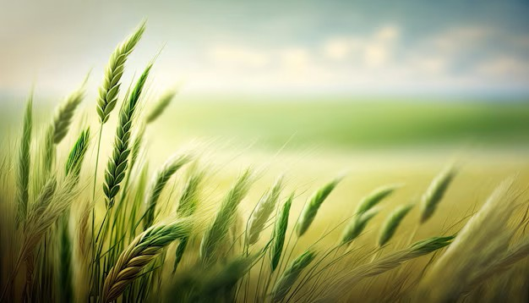
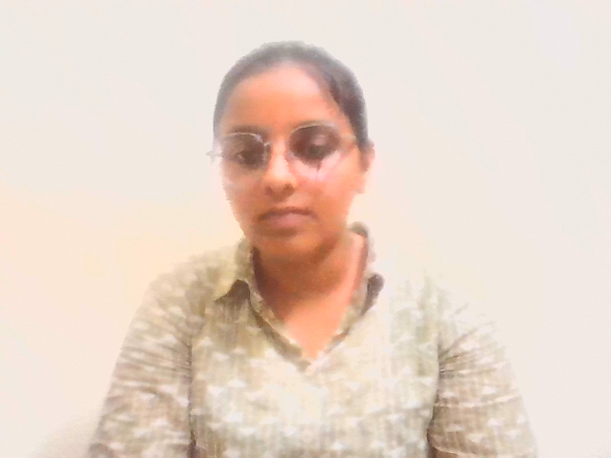
social internship-final presentation
Social Internship-final Presentation
Name: K.Nandini
Roll Number: 2400033341
Branch: B.Tech-CSE
Internship Mode: Remote
Name: K.Nandini
Roll Number: 2400033341
Branch: B. Tech-CSE
Internship Mode: Remote

Slide 2
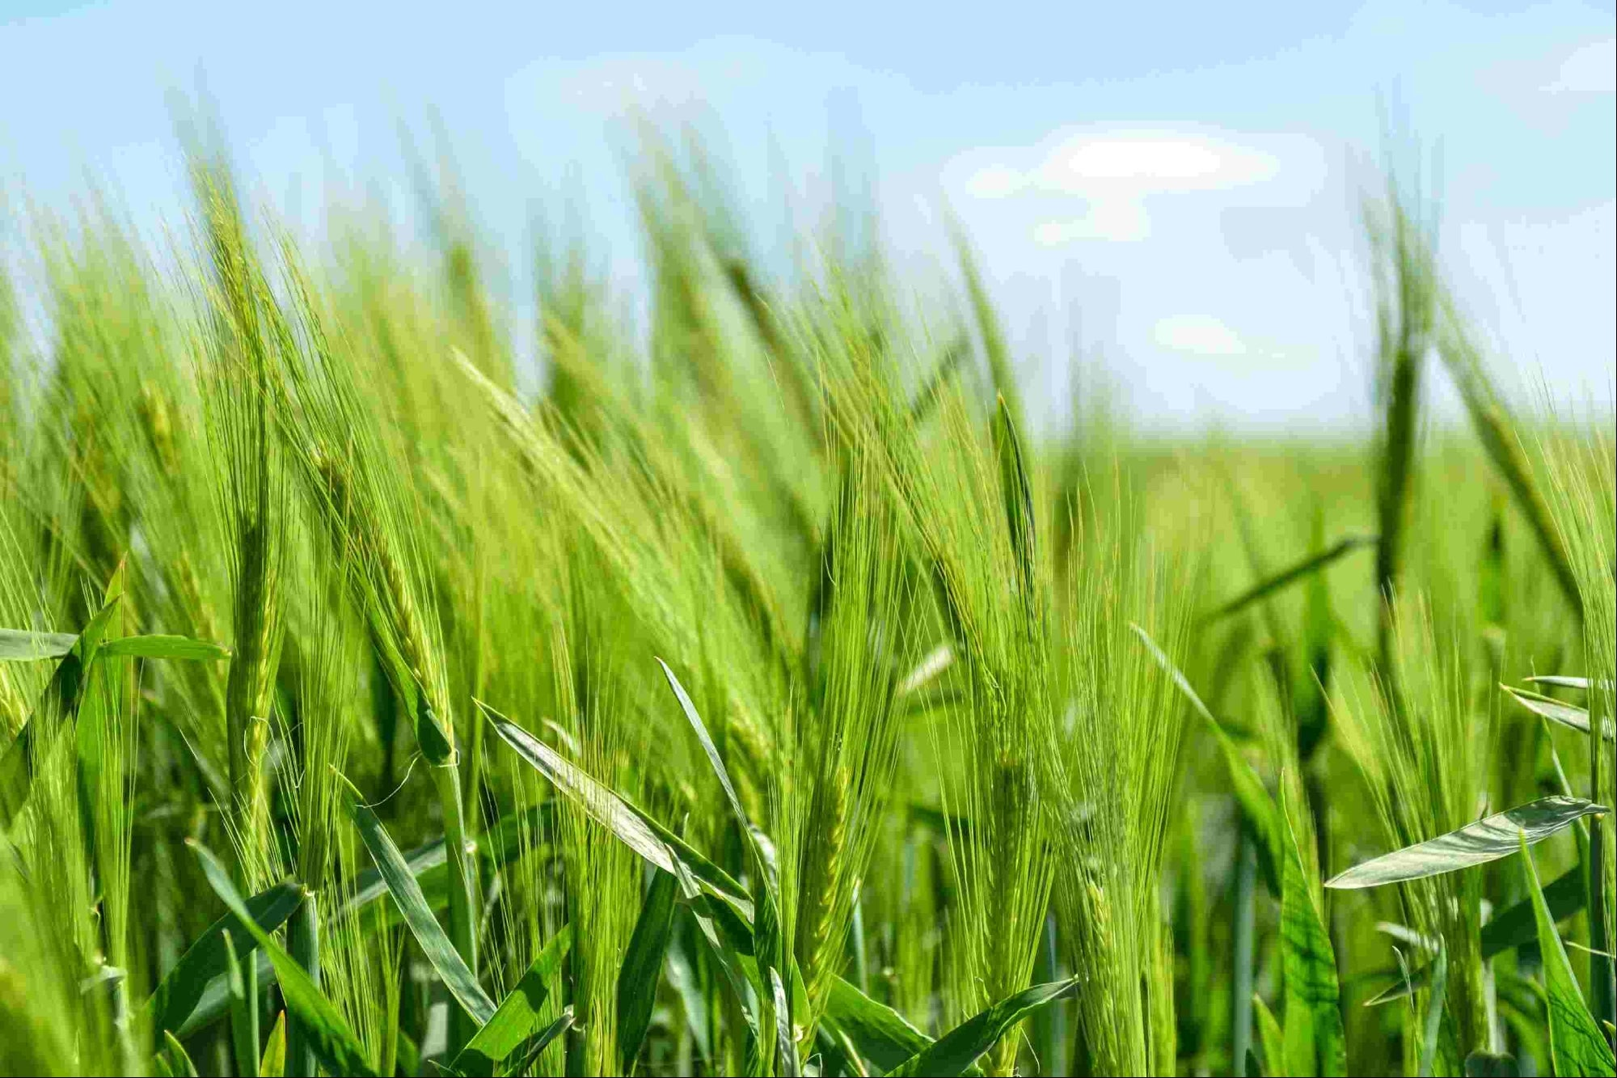
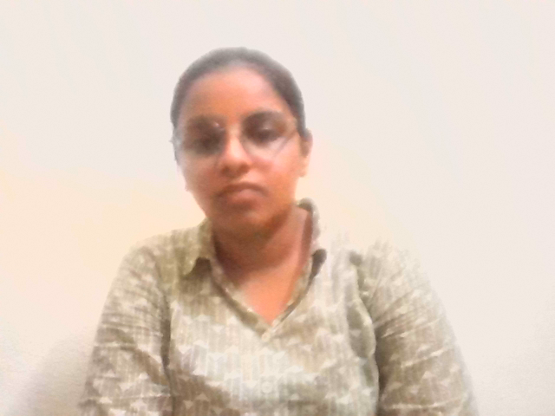
VERY PERI
Understanding the Domain – Agriculture
Understanding The Domain-Agriculture
Purpose: The purpose of agriculture is to grow food and raise animals to feed people.
Linked SDGs:
SDG 2: Zero Hunger – Helps produce enough food for everyone
SDG 13: Climate Action – Encourages climate-smart agriculture
SDG 15: Life on Land – Protects soil and land for future use
SDG 6: Clean Water and Sanitation-Encourages efficient use of water in farming
Key Activities:
Support Small Farmers ➤ Provide training, tools, and fair prices to farmers
Use Organic Fertilizers ➤ Compost and manure improve soil health without chemicals.
Rainwater Harvesting ➤ Collect and store rainwater for farming or daily use.
Village Relevance:
Main source of income
Pusalpahad is a small village where most people are farmers. They grow crops like wheat, rice, sugar cane cotton and vegetables. Depends on seasonal crops
Purpose: The purpose of agriculture is to grow food and raise animals to feed people.
Linked SDGs:
SDG 2: Zero Hunger – Helps produce enough food for everyon
SDG 13: Climate Action – Encourages climate-smart agriculture
SDG 15: Life on Land – Protects soil and land for future use
SDG 6: Clean Water and Sanitation-Encourages efficient use of water in farming
Key Activities:
Support Small Farmers ➤ Provide training, tools, and fair prices to farmers
Use Organic Fertilizers ➤ Compost and manure improve soil health without chemicals.
Rainwater Harvesting ➤ Collect and store rainwater for farming or daily use.
Village Relevance:
Main source of income
Rampur is a small village where most people are farmers. They grow crops like wheat, rice, and vegetables. The food produced in Rampur is sold in nearby towns and cities.
Introducing the Pantone Color of the Year 2022. PANTONE 17-3938 Very Peri is a dynamic hue that blends the faithfulness and constancy of blue with the energy and excitement of red.
The four color palettes in this template feature Very Peri to help you express your ideas and convey the right mood. Read on to learn how to use these colors in any presentation.

Slide 3
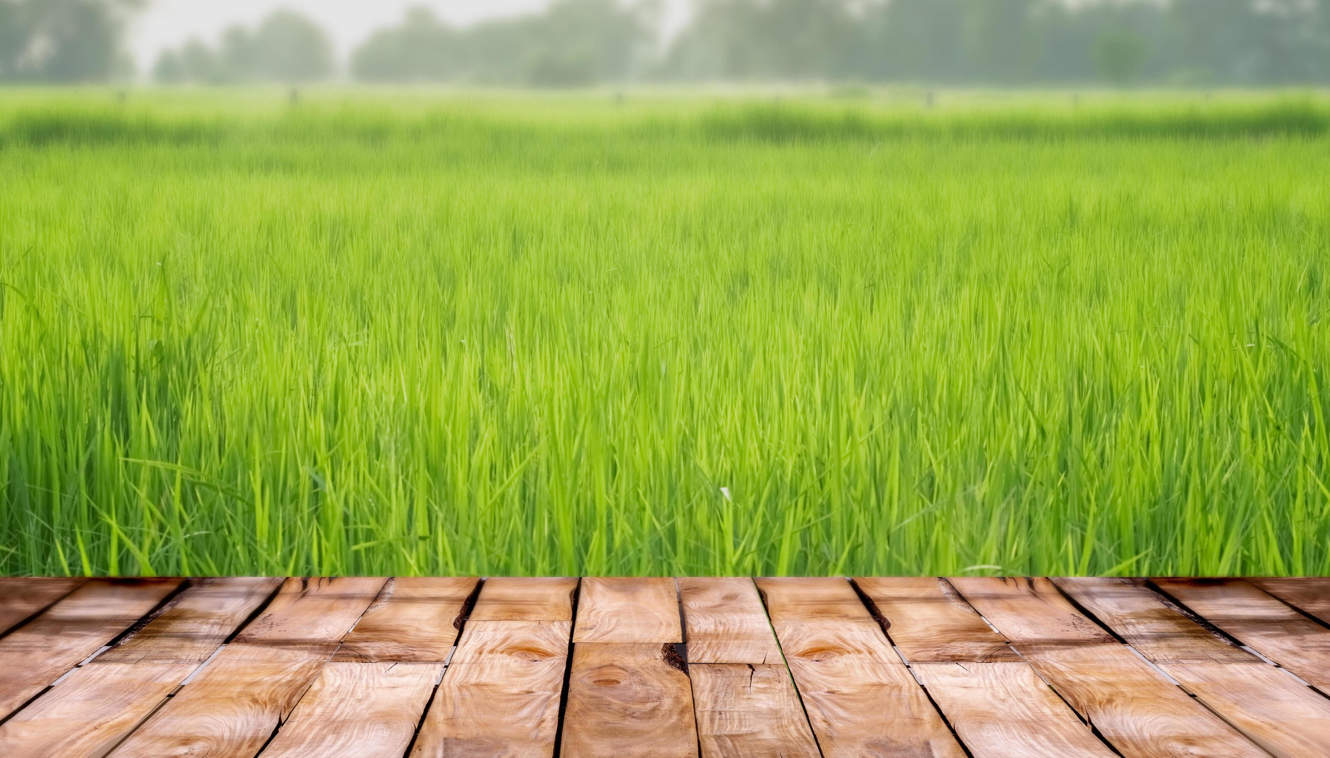
My 7-Day Journey – Learnings & Hurdles
Daily Activities Summary:[Day1 to Day7]
Morning routine: Fitness, yoga, Swachhata tasks
Field work: Surveys, stakeholder interviews, awareness sessions
Research: Domain study, problem identification, poster making
Community tasks: Cleanliness drives, LIPI cultural tasks, composting, children engagement
Resolutions:
Built rapport through repeated visits
Carried water and protective gear for outdoor work
Made a daily schedule and prioritized tasks.
Key Learnings:
Understood real challenges faced by farmers
Learned sustainable agriculture practices
Gained confidence in public interaction and awareness building
Improved time management and teamwork
Challenges Faced:
Hesitation from locals to share opinions
Harsh weather during field visits
Water Scarcity: Unreliable water sources affected crop yields.

Slide 4
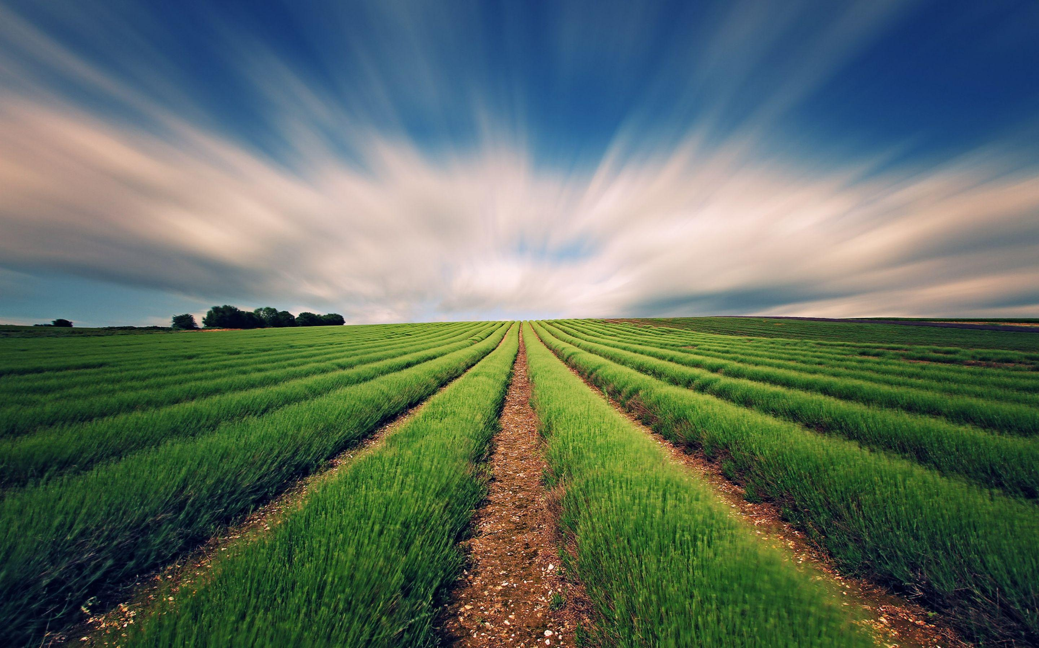
Identified Problem and My Intervention
Problem Statement: Crop damage due to the unpredictable weather conditions, especially sudden heavy rains
Actions Implemented:
Organized awareness sessions on organic farming
Shared easy composting techniques and benefits of natural fertilizers
Helped farmers build small rainwater harvesting structures.
Encouraged crop rotation to improve soil health
Mini Case Study: Mr. srinu, a small farmer, last season due heavy rains my fields are damaged and many crops,then they dug drainage channels and applied much to protect the soil. Now, crops are growing better.
Steps Taken:
Conducted surveys and interviews with local farmers
Researched effects of chemical farming on soil health
Support farmers with better tools and training.
Outcomes:
Farmers showed interest in trying organic methods
3 farmers started composting at home
Improved understanding of eco-friendly practices
Farmers started using less water and saved more during irrigation.
Rainwater harvesting helped improve water availability for crops.

Slide 5
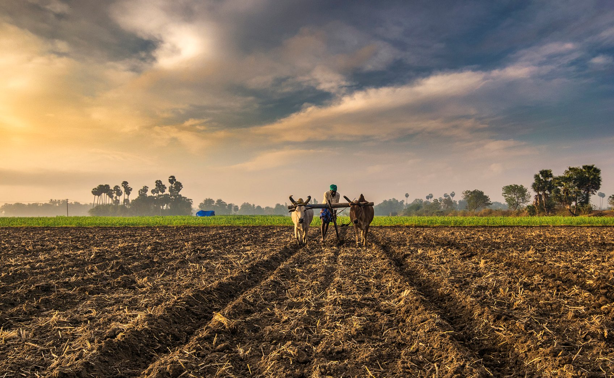
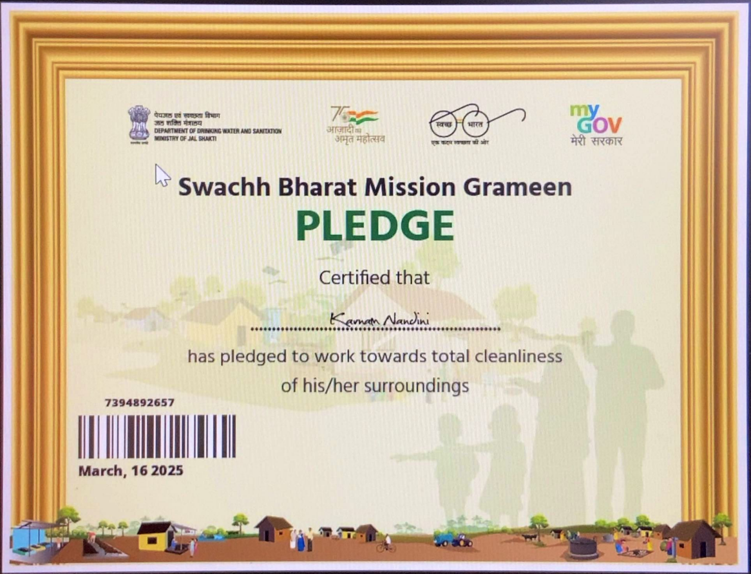
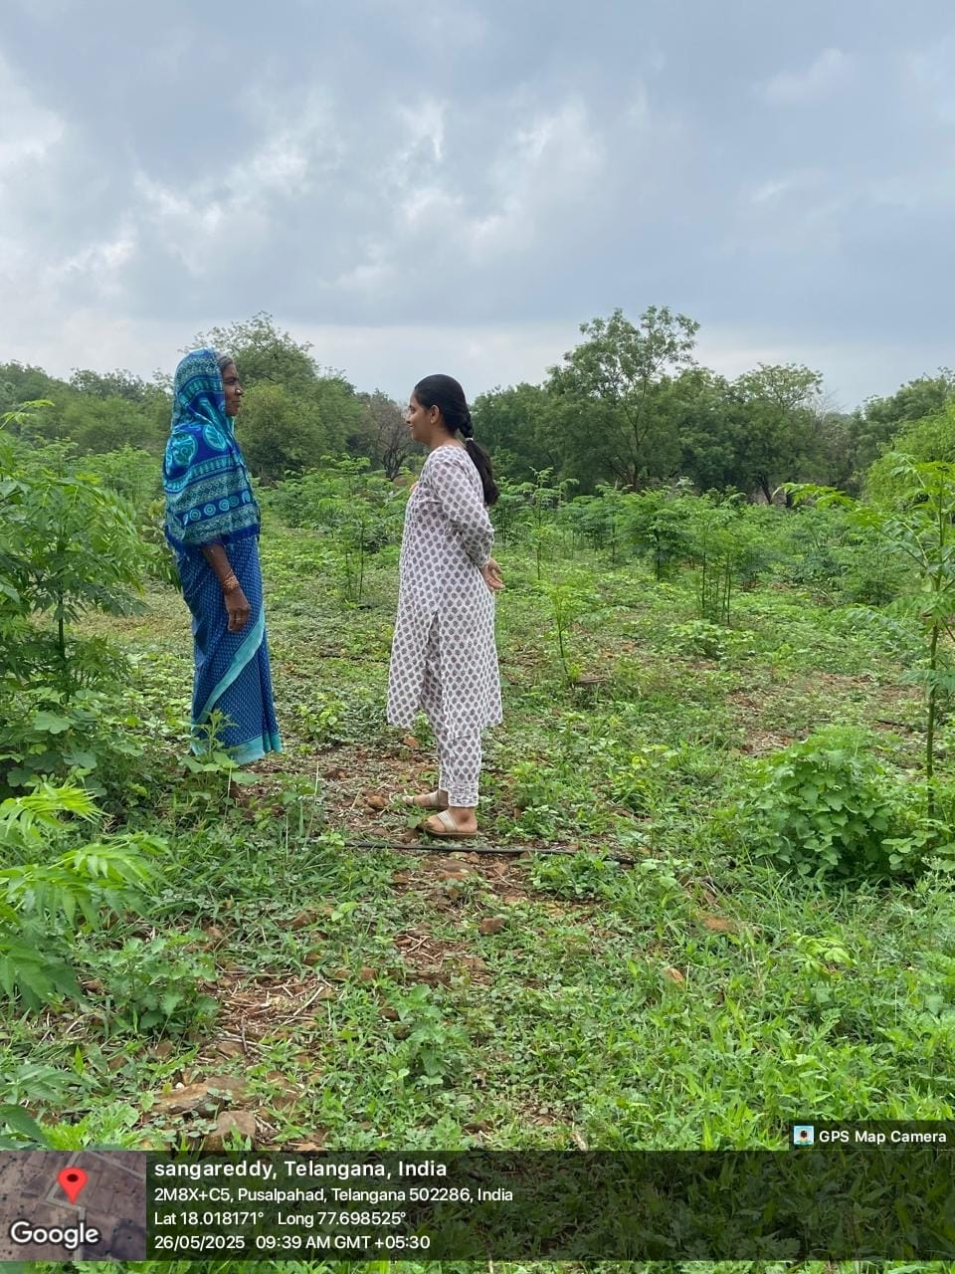
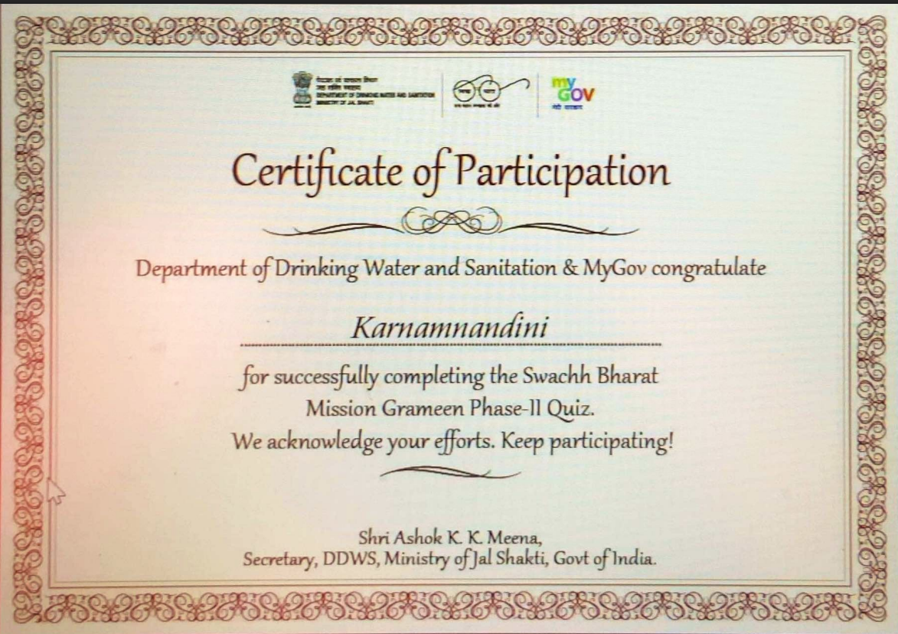
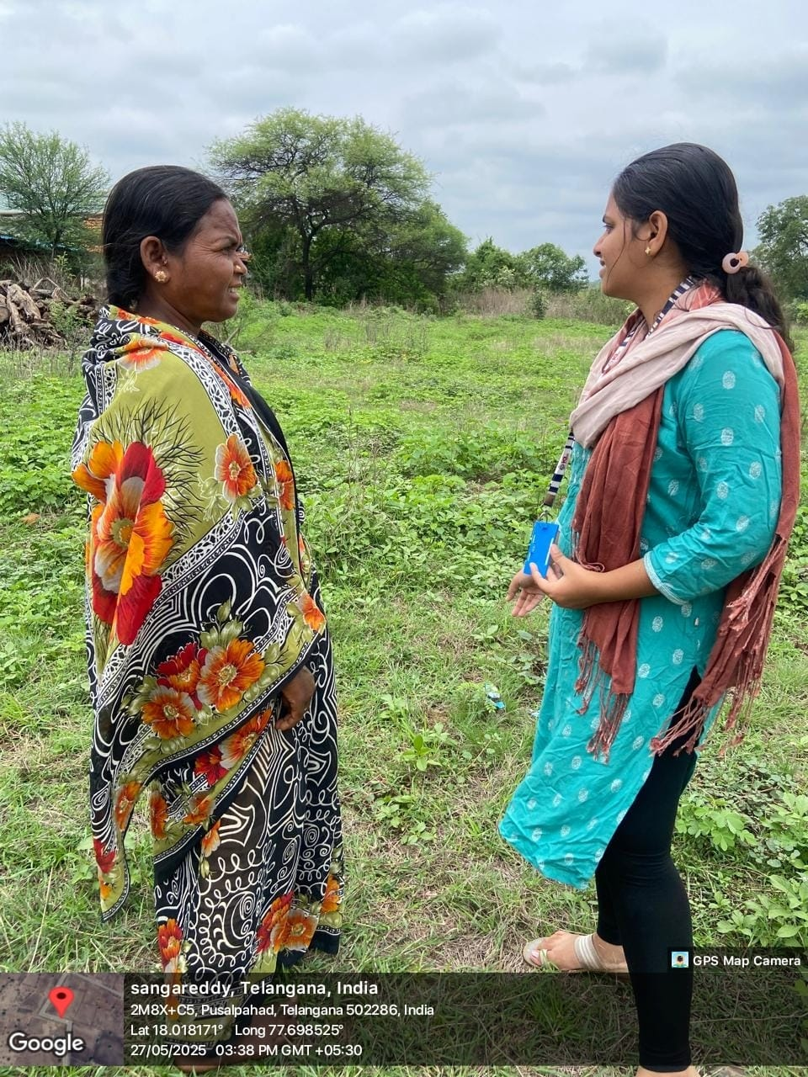
WELLSPRING
Documentation and Impact Proof
Documentation and Impact Proof
Government certificate screenshots
Geo Tagged photos from the field
Government certificate screenshots

Slide 6
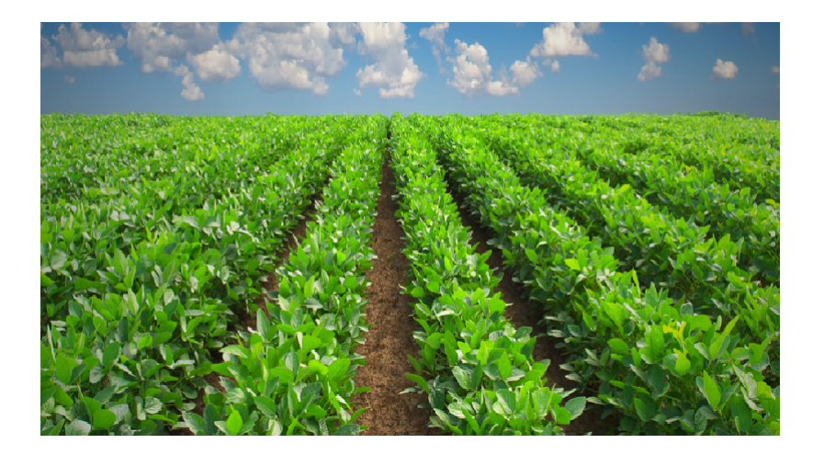
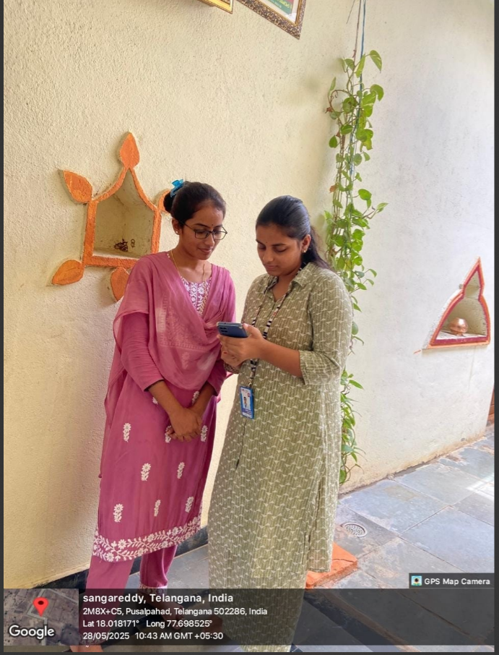
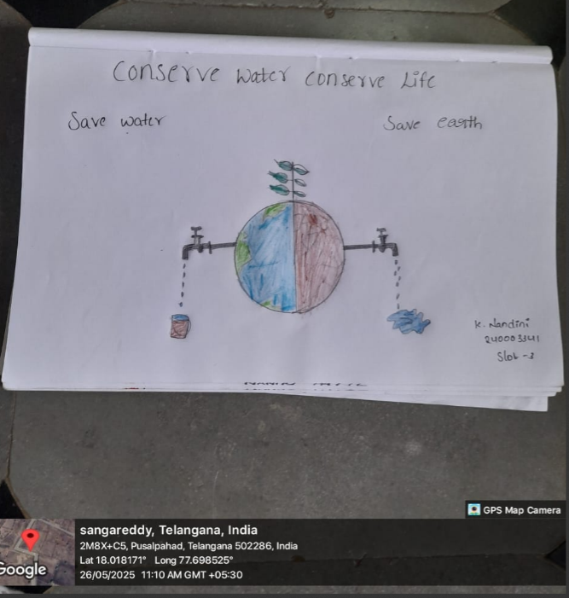
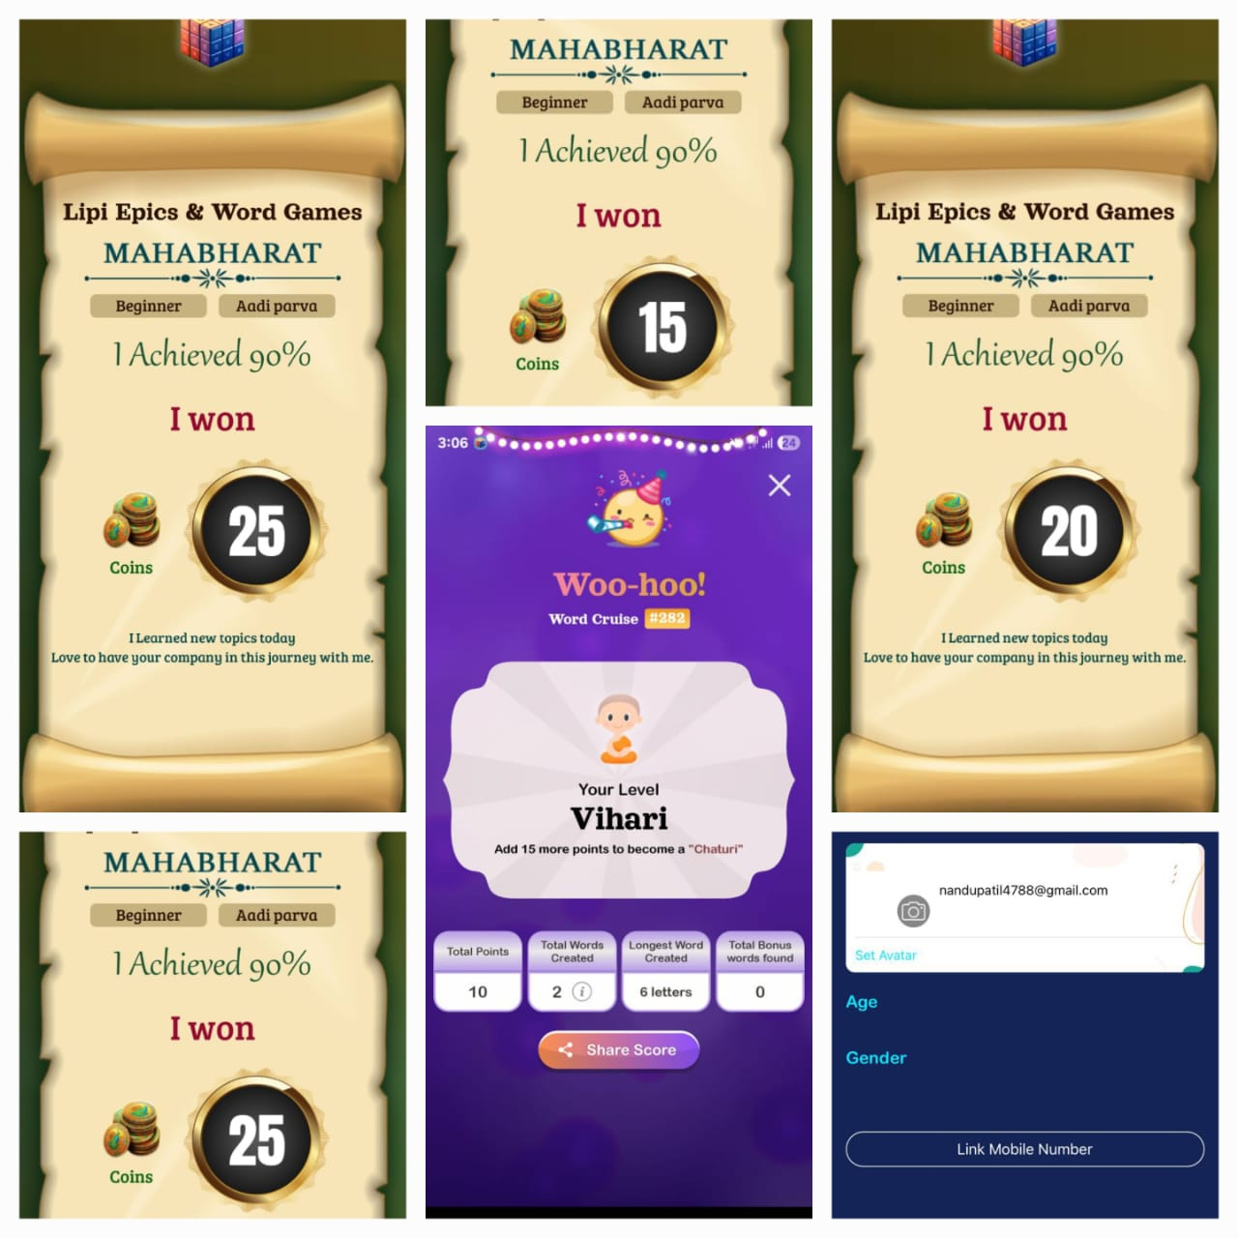
WELLSPRING
Use this color palette when you want a blend of nature-infused hues that highlight the compatibility of the greens and the “health giving” properties of these deliciously subtle and nourishing hues.
LIPI TASK(Successfully Completed Aadi Parva)
MINI SURVEY
POSTER FOR BRINGING AWARENESS

Slide 7

THE STAR OF THE SHOW

